Slide 1
KAPASA MAKASA UNIVERSITY
Topic - Multimedia
Presented to
3RD YEAR CYBER
CLASS
Presented by
NGOSA GATHAMS

Slide 2
RESEARCH claim that humans get their information in the following ways:
• more than 80 % by sight - of which 20 % is remembered
• 11 % by hearing - of which 30 % is remembered
• 3.5 % by smell
• 1.5 % by touch and taste.
... where 50 % of what is both seen and heard is remembered
... further 80 % of what is seen, heard and done, is remembered
That is, multiple, media, and interactive should be a good thing

Slide 3
Classification of multimedia
Text - ASCII/Unicode, HTML, Postscript, PDF
• Audio – Sound, music, speech, structured audio (e.g. MIDI)
• Still Image - Facsimile, photo, scanned image
• Video (Moving Images) – Movie, a sequence of pictures
• Graphics – Computer produced image
• Animation – A sequence of graphics images
• Discrete Media (DM, Static): text, image, graphics
• Continuous Media (CM, Dynamic): audio, video, animation
• Captured vs Synthesized media
• Standalone vs Networked media

Slide 4
Why multimedia is important
Digital audio/video is revolutionizing music, film, game, and video &
audio industries
• Convergence of computers, telecommunication, radio, and TV
– Caused by technology and competition
– Dramatic changes in products and infrastructure
• New application potential
– Huge potential markets
– Improving our lives (learning, entertainment, and work)
• Interesting technical issues

Slide 5

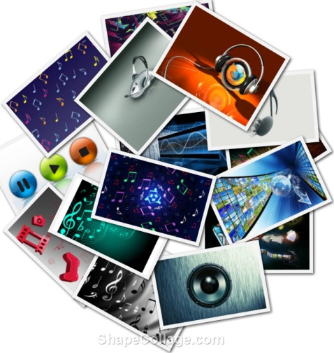
Multimedia
  Multimedia is a combination of text, sound, graphics, video, and animation delivers by computer or any other electronic media.
  image for example-

Slide 6
Text
GRAPHIC
MULTIMEDIA
VIDEO
AUDIO
ANIMATION

Slide 7
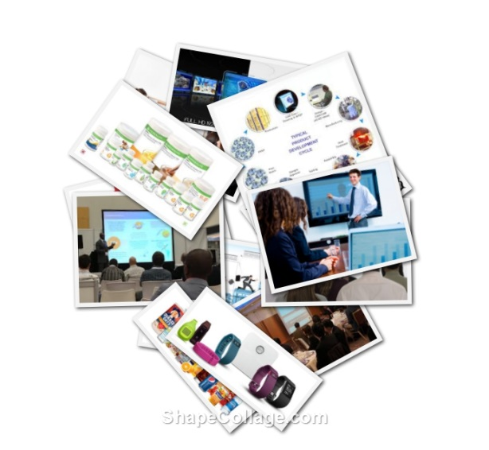
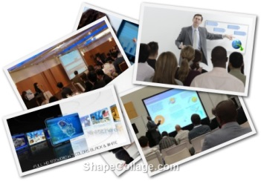
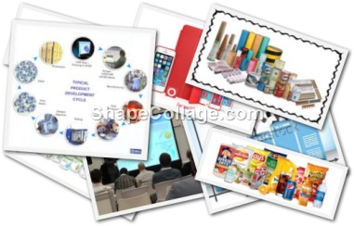

Use of area
Multimedia use in Business
Business application for multimedia include presentation, Training, advertisement, video, conferencing and etc. For example– sells person can learn and Provide poster with the help of multimedia.
Image for example-

Slide 8
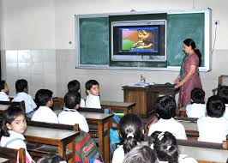
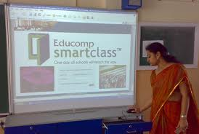
Multimedia use in education
  Multimedia is better form of teaching school and
  college . Multimedia presentations are grate way to introduce new concepts or explain a new technology. For example - an electronic game which plays various poems for bits , smart classes.
  example-

Slide 9
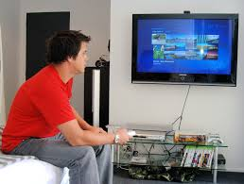
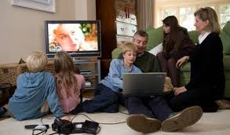
Multimedia use at Home
From gardening, cooking, home design, remodeling, and repair to genealogy software, multimedia has entered the home. Today, home consumers of multimedia own either a computer with an attached CD-ROM or DVD drive or a set-top player that hooks up to the television, such as a Nintendo Wii, X-box, or Sony PlayStation machine. There is increasing convergence or melding of computer based multimedia with entertainment and games-based media traditionally described as “shoot-em-up.”

Slide 10
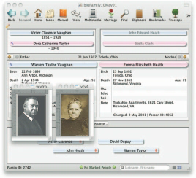



Multimedia use at Home
Nintendo alone has sold over 118 million game players worldwide along with more than 750 million games.
Image for example-

Slide 11
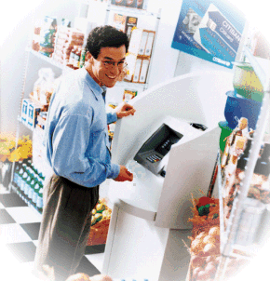
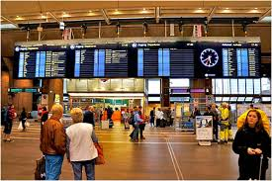
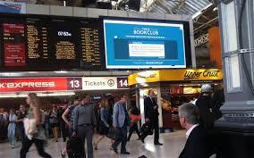
Multimedia use in public place
In hotels, train stations, shopping malls, museums, libraries, and grocery stores, multimedia is already available at stand-alone terminals or kiosks, providing information and help for customers in the interactive manner and also the reduce the personal work or manual work of the 24 hours.
For example –A hotel may provide following information like as city map schedule of airlines services Available in hotel .

Slide 12

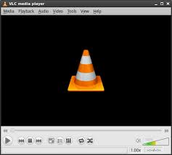
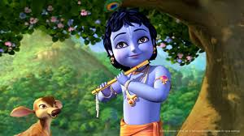
Elements of multimedia
Multimedia elements all the object to create any type of multimedia project .For better project element should be arranged properly. Their are following elements-
Text
Image
Sound
Animation
Video

Slide 13

Text
All multimedia contains some amount of text. The text can have different of font and size to suit the presentation.
The text use in multimedia can be perform in different format general Text , hyper text, pdf.
Example-

Slide 14
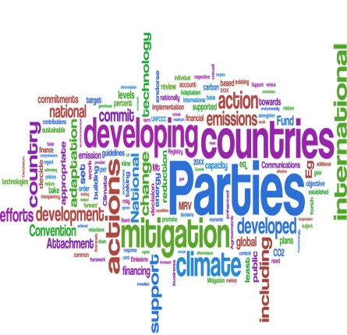


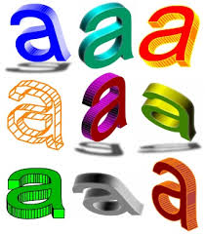


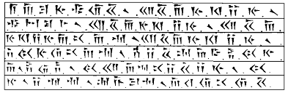
TEXT

Slide 15
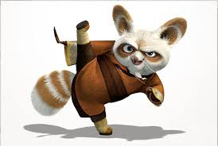

Image
It is important and interesting component of multimedia is image . It is one of basic fact in multimedia is that people do not like reading large amount of text information . So graphics are used to make better presentation .
Image

Slide 16
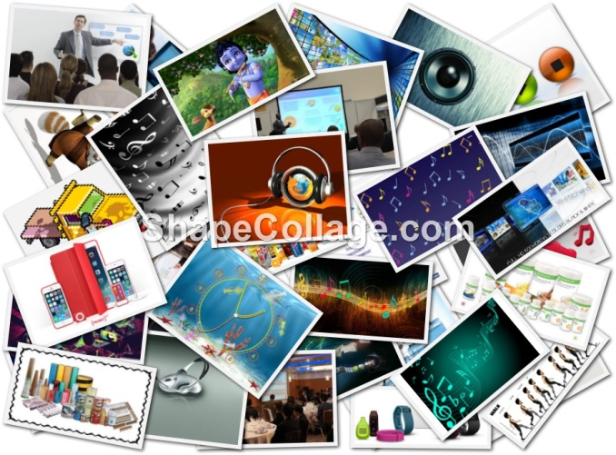
Image
Image also assumed that a subject is better explain to human when represent it in graphics form . There are several technology and source available to produce image graphics for multimedia project , image can be created by using paint program by scanning photograph.
Example-

Slide 17
Sound
Sound is perhaps the most sensuous element of multimedia. It is a meaningful speech in any language it can make the difference between an ordinary multimedia a presentation and professional multimedia presentation. Sound is a form of energy that propagates as a web. It is categorized by frequency ,web length, amplitude, speech etc.
MONO
STEREO

Slide 18
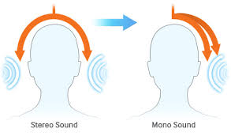
Mono Vs. Stereo
Stereo (or Stereophonic sound) is the reproduction of sound using two or more independent audio channels in a way that creates the impression of sound heard from various directions, as in natural hearing. Mono (Monaural or monophonic sound reproduction) has audio In a single channel, often centered in the “sound field”. i.e. and stereo
(Stereophonic) are classification of sound. Stereo sound has almost completely replaced mono because of the improved audio quality that stereo provides.

Slide 19
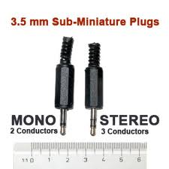
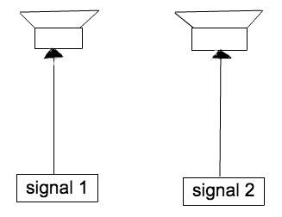
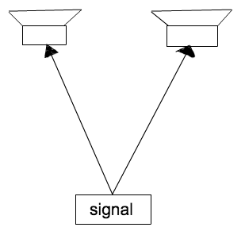
Applications of mono vs. stereo
Mono sound is preferred in radiotelephone communications, telephone networks, and radio stations dedicated to talk shows and conversations, public address system, hearing aids. Stereo sound is preferred for listening to music, in theaters, radio stations dedicated to music, FM broadcasting and Digital Audio Broadcasting (DAB).

Slide 20
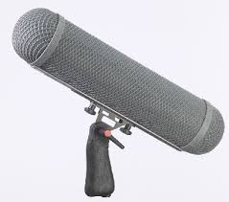

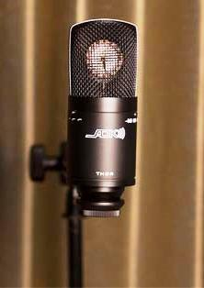
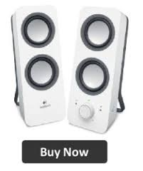
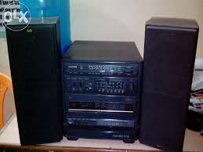

EXAMPLE
STEREO
MONO

Slide 21

Animation
animation makes static presentations come alive. It is visual change over time and can add great power to your multimedia projects and web pages. Many multimedia applications for both Macintosh and Windows provide animation tools.
This makes it possible for a series of images that are changed very slightly and very rapidly, one after the other, to seemingly blend together into a visual illusion of movement.

Slide 22

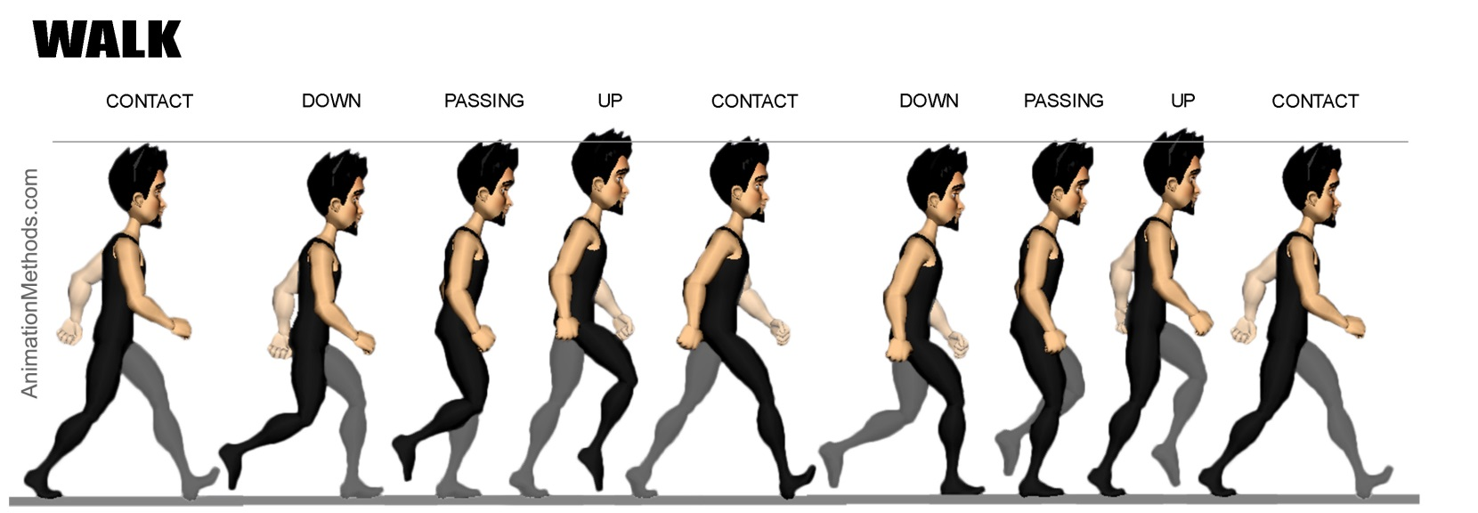
Animation
The illustration shows a few sells, or frames, of a rotating logo. When the images are progressively and rapidly changed, the arrow of the compass is perceived to be spinning.
Example -

Slide 23
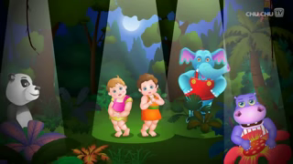
Video
It is the technology of capturing, recording, processing, transmitting, and reconstructing moving pictures.
video is more towards photo realistic image sequence / live recording as in comparison to animation. Video also takes a lot of storage space. So plan carefully before you are going to use it. Example-

Slide 24
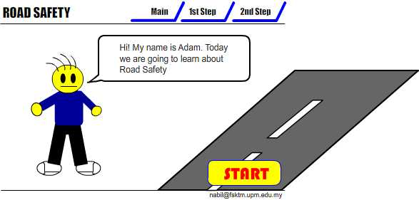
Interactive Multimedia
When the user is given the option of controlling the elements.
Example_

Slide 25
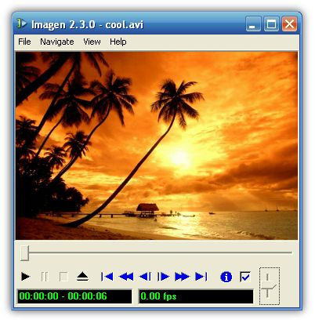


Hyper Media
A combination of hypertext, graphics, audio, video, (linked elements) and interactivity culminating in a complete, non-linear computer-based experience.
Example
Main Page
Video link
Image link
Audio Link

Slide 26
THE END

